Slide 1
Project Based Learning -IV
Team Details: Meharjot Singh(2310993876)
Nishant Garg(2310993891)
Faculty Coordinator: Rajan Sir
:
Chitkara University Institute of Engineering and Technology,
Chitkara University, Punjab

Slide 2
Table of Contents
Introduction
Problem Statement
Technical Details
Key Features
Project Highlights
Conclusion
References/Links used

Slide 3
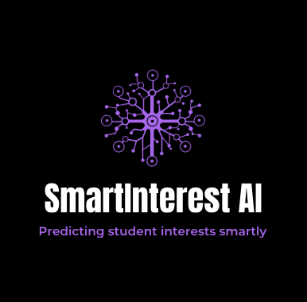
Introduction
SmartInterest AI – "An AI-Powered Academic Interest Predictor"
Choosing the right academic and career path is a major challenge for students, especially when guidance is based on generic or manual counseling. SmartInterest AI is designed to solve this problem by using machine learning to predict a student’s domain of interest based on their academic marks and project experience. The system analyzes subject-wise performance and maps it to relevant technical domains, comparing it with the domains of completed projects. By identifying overlaps, it accurately infers areas like AI, Web Development, or Cybersecurity as the student's likely interest. With high accuracy achieved using models like XGBoost, SmartInterest AI offers a reliable and scalable solution for personalized guidance. The goal is to help students make informed decisions and support educators in providing targeted mentorship through a web-based platform.

Slide 4
Problem Statement
In the current educational system, students often lack the necessary guidance to choose a career path aligned with their interests and strengths. Traditional counseling methods are usually generalized, subjective, and impractical to implement at scale for large student populations. As a result, many students make uninformed decisions, leading to disengagement and poor academic or career outcomes. Although academic data and project records are available, they are rarely used to provide meaningful, personalized advice. There is a need for a smart, data-driven solution that can analyze a student’s academic performance and project experience to predict their domain of interest. This would help both students and educators make informed, confident decisions regarding learning pathways and future career planning.

Slide 5
Technical Details
1. Dataset Configuration
Total Records: 300,000 students
Data Includes:
>Subject Marks in six technical areas:
>Operating System, DSA, Frontend, Backend, Machine Learning, Data Analytics
>4 Project Domains per student (e.g., AI, Web Dev, Robotics)
2. Labeling Logic for Interest Prediction
Identify top 3 subjects by marks
Map each subject to predefined domains using a custom dictionary
Compare with project domains
If a common domain exists, it is selected as the predicted label
If no match, label = Unknown (removed from training)

Slide 6
3. Data Preprocessing
Project domains encoded numerically
Flattened project fields to separate columns
Removed rows with “Unknown” labels
Final dataset saved as: cleaned_student_data.csv
4. Model Training
Models Tested: XGBoost, Random Forest, Logistic Regression, KNN
Best Model: XGBoost (96% accuracy)
Final model saved as: smartinterest_model.pkl
5. Deployment (Planned Web Application)
Frontend: React.js
Backend: Flask (Python API with model endpoint)
6. Output Features:
Predicted domain of interest
Personalized learning roadmap for students

Slide 7
Key Features
Student Data Analysis:
Analyzes academic performance (marks in specific subjects) and project involvement (domains) to predict student interests.
Domain Mapping:
Utilizes a predefined mapping between subjects (e.g., Operating Systems, DSA, Frontend, Backend) and relevant domains (e.g., AI, Cybersecurity, Web Development).
Interest Domain Prediction:
Predicts student interest based on their top subjects and project domains, ensuring personalized recommendations.
Data Preprocessing:
Handles missing/unknown labels by removing those records from the dataset to ensure model accuracy.

Slide 8
High-Performance Machine Learning Models:
Uses XGBoost (96% accuracy) for best performance.
Evaluates various models (Random Forest, Logistic Regression, KNN) and selects the optimal one for deployment.
Personalized Academic and Career Guidance:
Provides predictions for a student's domain of interest.
Offers a roadmap for improving strong and weak subjects to align with career goals.
Web Application Features:
User login and registration for personalized interaction.
Simple input interface: marks and project domains.
Predicts the student's domain of interest with a personalized learning roadmap.
Future Enhancements:
Confidence scores and explanations for predictions.
Course suggestions and domain-specific career advice.
Teacher dashboard for analytics on student performance and interests.

Slide 9
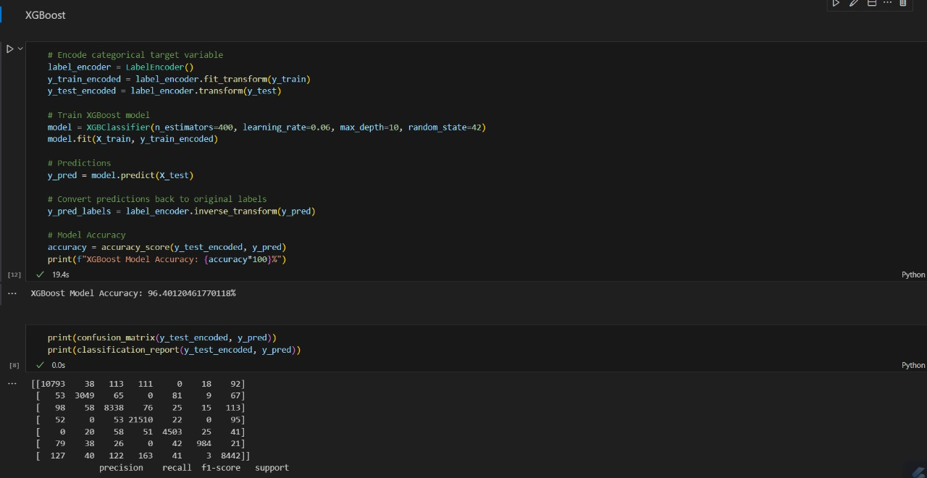
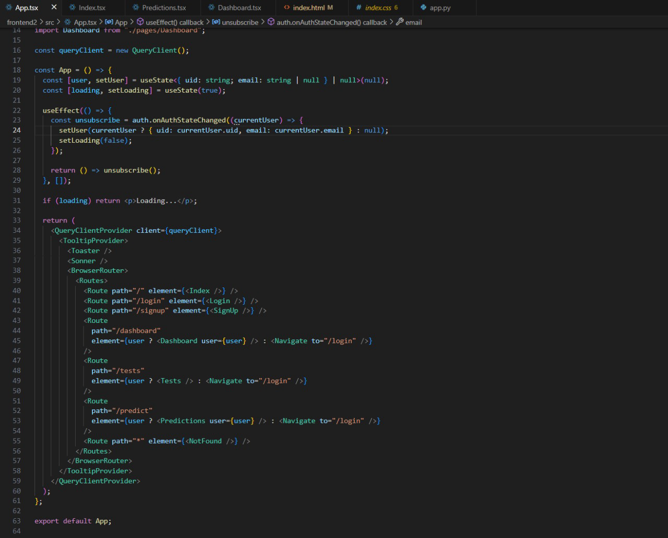
Project Highlights
Fig1. XGBoost Model Training and Evaluation Results.
Fig 2. App Component Routing and Authentication Handling in React.

Slide 10
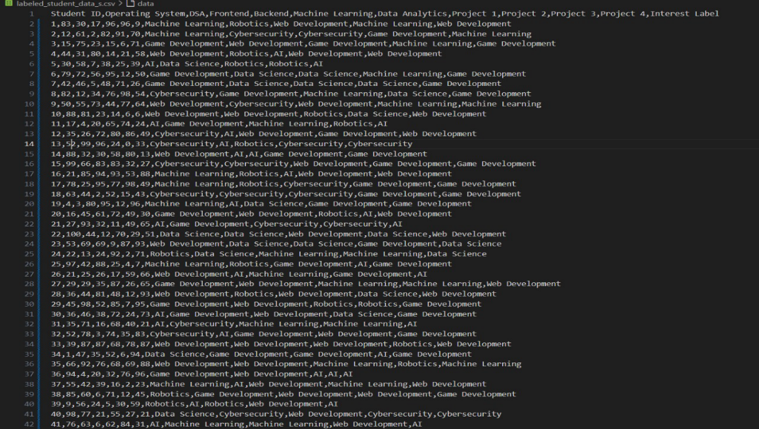
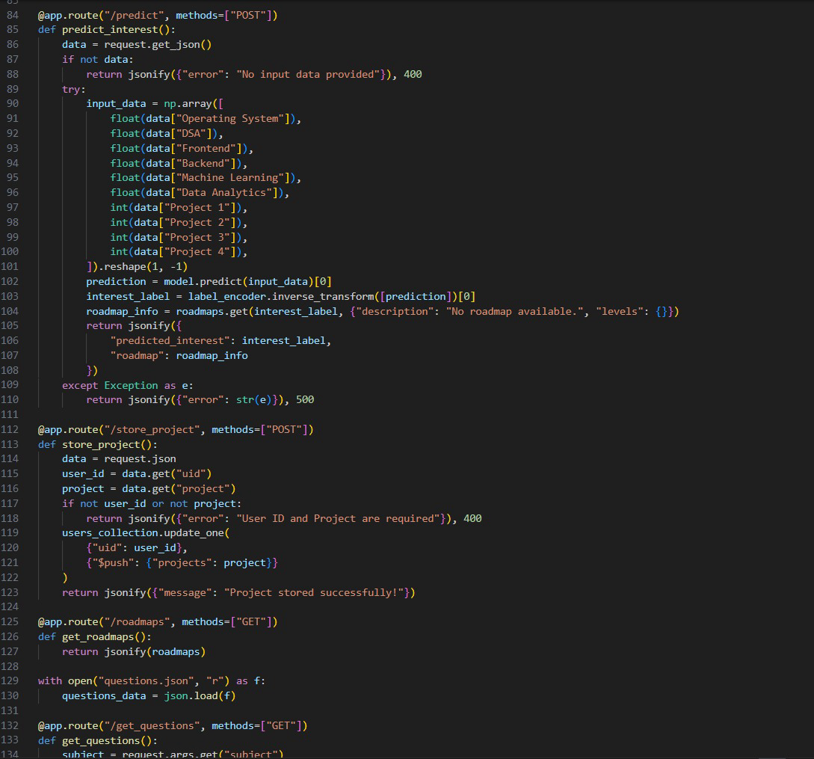
Project Highlights
Fig 3. Labeled Student Skill and Interest Dataset Overview.
Fig 4. Flask Backend: Interest Prediction and Roadmap Management API

Slide 11
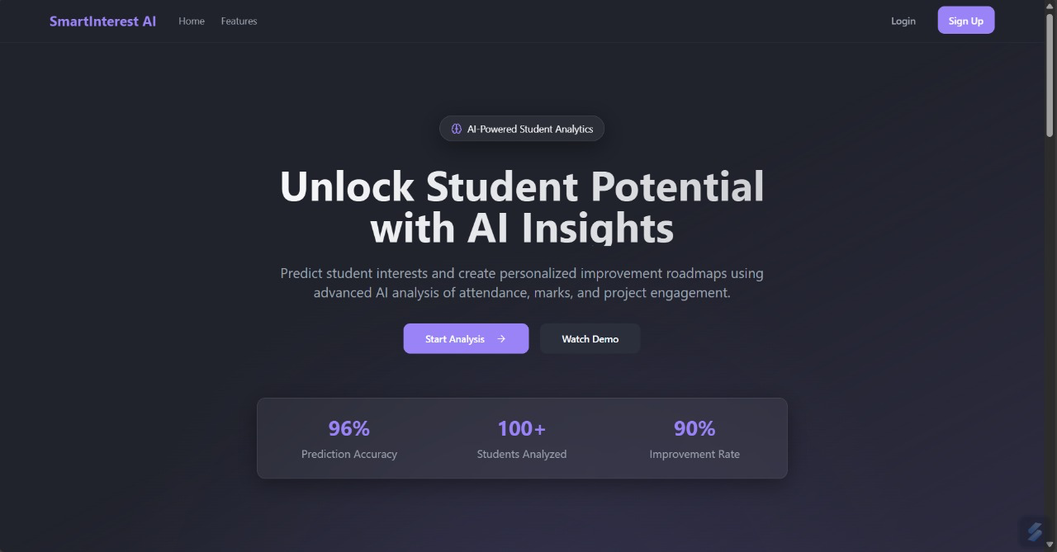
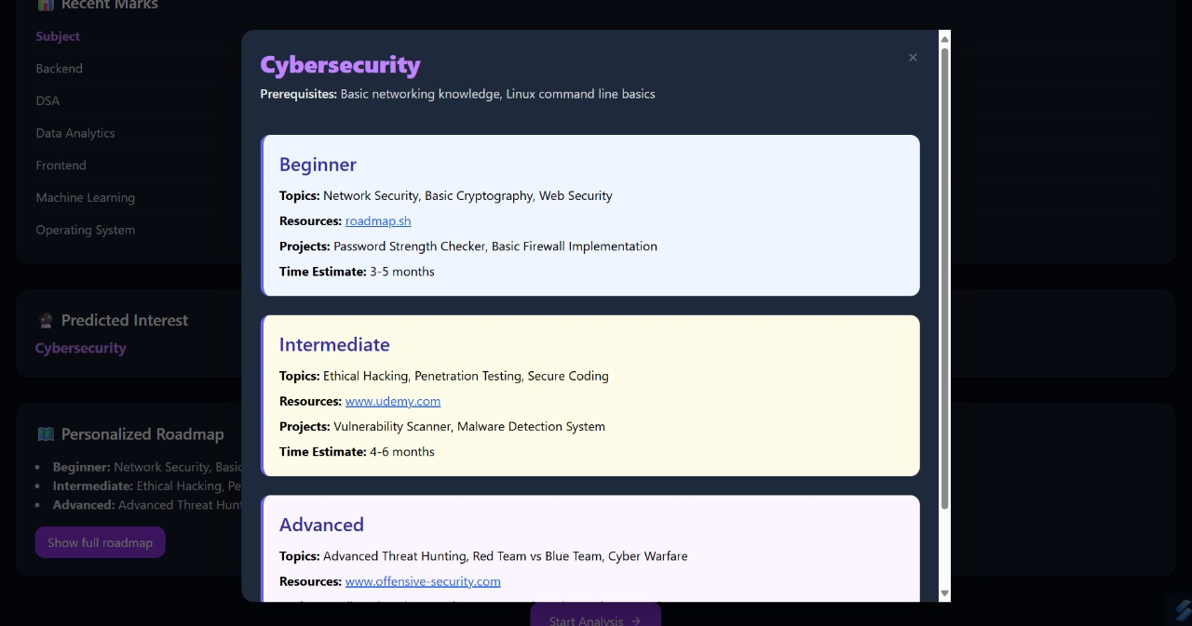
Project Highlights
Results:
Fig5. Homepage of SmartInterest AI Platform.
Fig6. Cybersecurity Personalized Roadmap Interface.

Slide 12
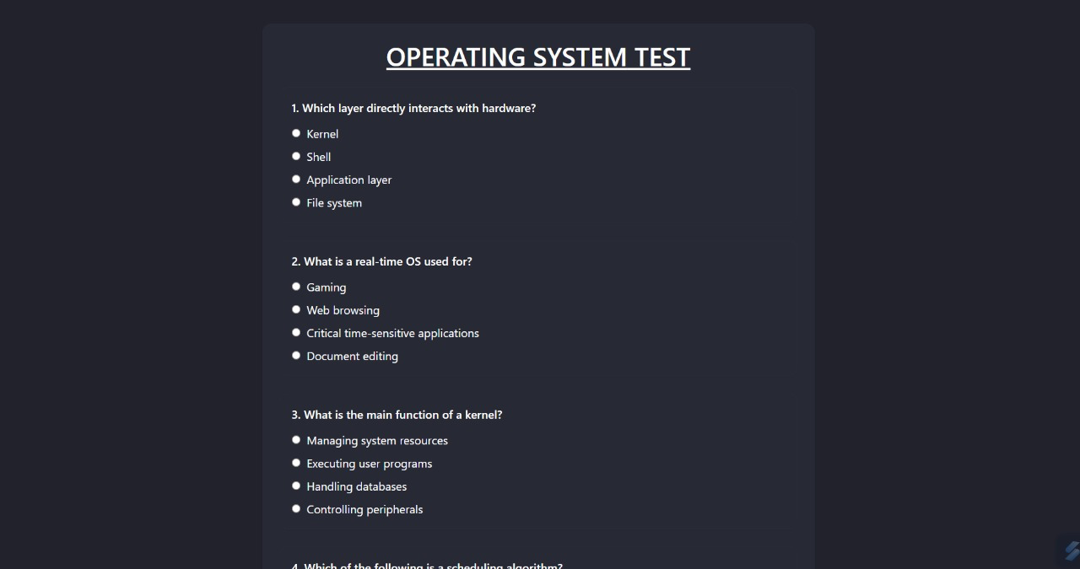
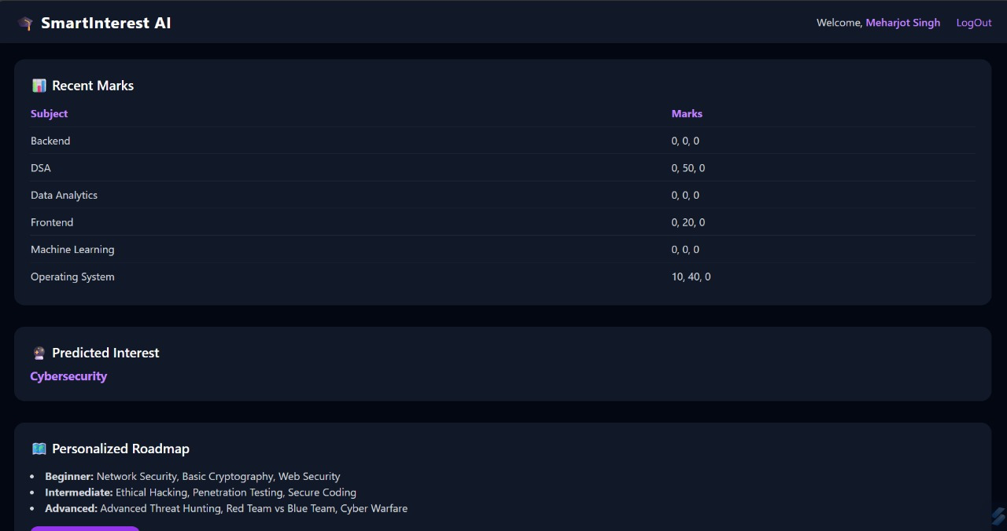
Project Highlights
Fig7. Operating System Test Module.
Figure 8. Subject Scores and Project Domain Selection.

Slide 13
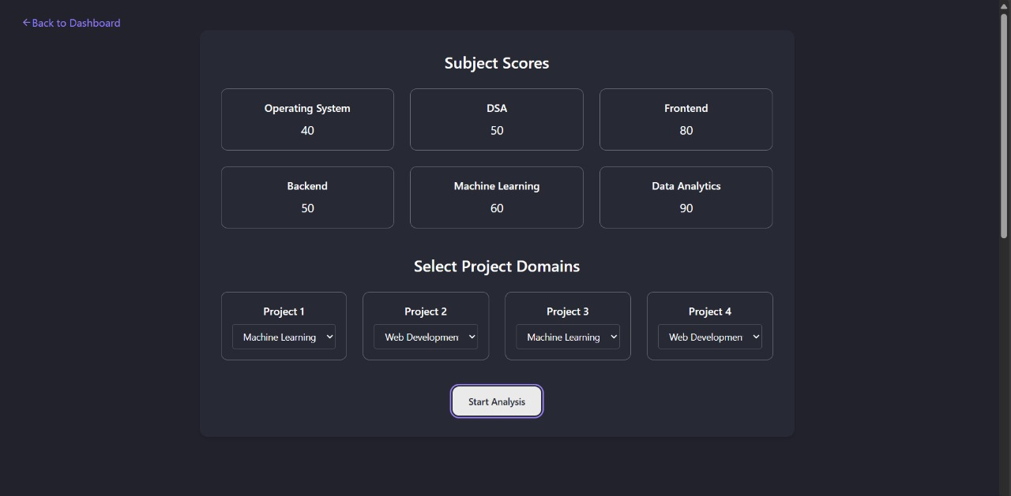
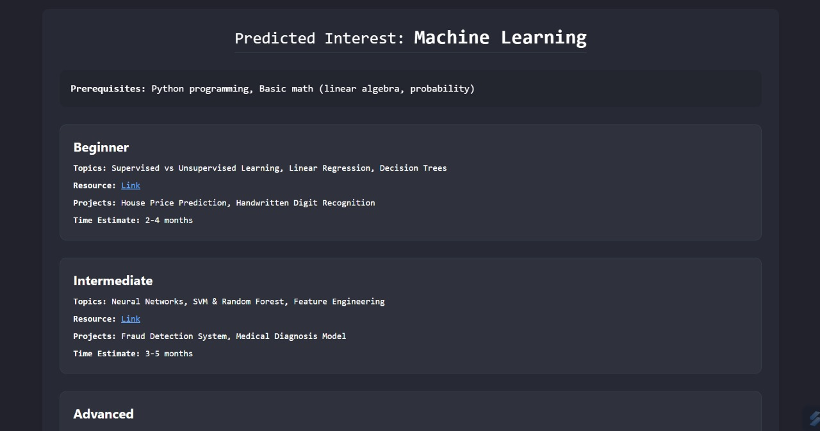
Project highlights
Fig9. Dashboard for Academic Performance and Project Preferences.
Fig10. Personalized Machine Learning Roadmap Generated by SmartInterest AI.

Slide 14
Conclusion
SmartInterest AI successfully demonstrates how machine learning can be applied to personalize academic and career guidance for students. By analyzing subject-wise academic performance and project domains, the system effectively predicts each student's area of interest, such as Artificial Intelligence, Web Development, or Cybersecurity. The project used a well-structured dataset of 300,000 records and applied a smart labeling mechanism to generate accurate training data. Through extensive experimentation, the XGBoost model was identified as the most effective, achieving an accuracy of 96%. The system is being developed as a web application to allow real-time predictions and student interaction. This tool not only benefits students by helping them make informed decisions but also supports educators in providing targeted mentorship. With future enhancements like confidence scores, course recommendations, and teacher dashboards, SmartInterest AI has strong potential to be a valuable addition to modern education systems.

Slide 15
References/Links used
1. Kaggle.com
2. www.geeksforgeeks.org
3. W3school
4. Codebasics.com

Slide 16


